Slide 1
Chapter 2
Factors: How Time and Interest Affect Money
2-<number>

Slide 2
LEARNING OUTCOMES
F/P and P/F Factors
P/A and A/P Factors
F/A and A/F Factors
Factor Values
Arithmetic Gradient
Geometric Gradient
Find i or n
2-<number>

Slide 3
REVIEW OF ENGINEERING ECONOMIC TERMS
Present worth (PW), present value (PV), and principal (P) all represent the value of money at time zero, which is the beginning of the engineering economic analysis period under investigation.
Future worth (FW), future value (F), or (Fn) represent the future sum of money including principal plus interest.
An annuity (A) is the term used to describe a series of uniform, end-of-period payments or disbursements. It is a series of equal payments made at equal intervals of time. For example, the monthly payments of a car loan where the amount and number of payments are known.
The salvage value is what an asset is worth at the end of its useful life.
Sunk cost represents funds not recoverable because they have already been expended some time in the past
© 2012 by McGraw-Hill, New York, N.Y All Rights Reserved
1-<number>

Slide 4
CASH FLOW DIAGRAMS
An important aspect of engineering economic analysis
If cash flow diagrams are drawn properly, then the diagrams are helpful when developing engineering economic solutions.
Cash flow diagrams are a visual representation of the flow of funds into and out of investment instruments, maintenance accounts, projects, and any other type of activity involving the movement of money.
© 2012 by McGraw-Hill, New York, N.Y All Rights Reserved
1-<number>

Slide 5
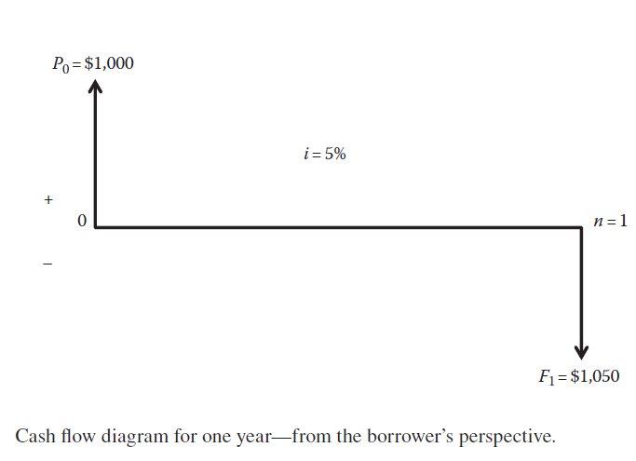
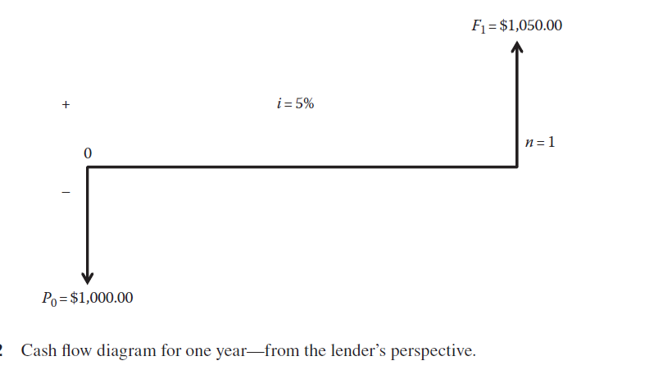
Drawing Cash Flow Diagrams
Cash flow diagrams are drawn either from a borrower’s point of view or from a lender’s point of view.
The initial principal amount is $1,000.00, the interest rate is 5%, and there is only one interest period in the year.
1-<number>

Slide 6
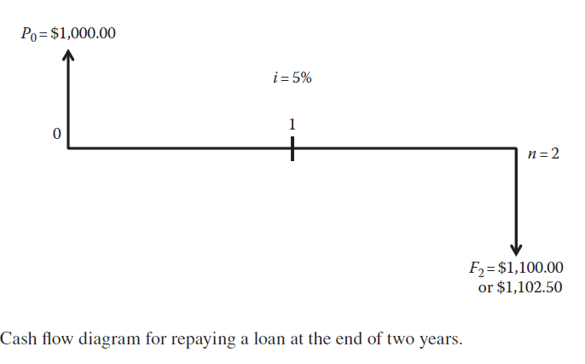
Drawing Cash Flow Diagrams
If the principal amount at time zero of $1,000.00 is not repaid at the end of the first year but is repaid at the end of the second year, the cash flow diagram would be the diagram from the borrower’s point of view shown below:
1-<number>

Slide 7
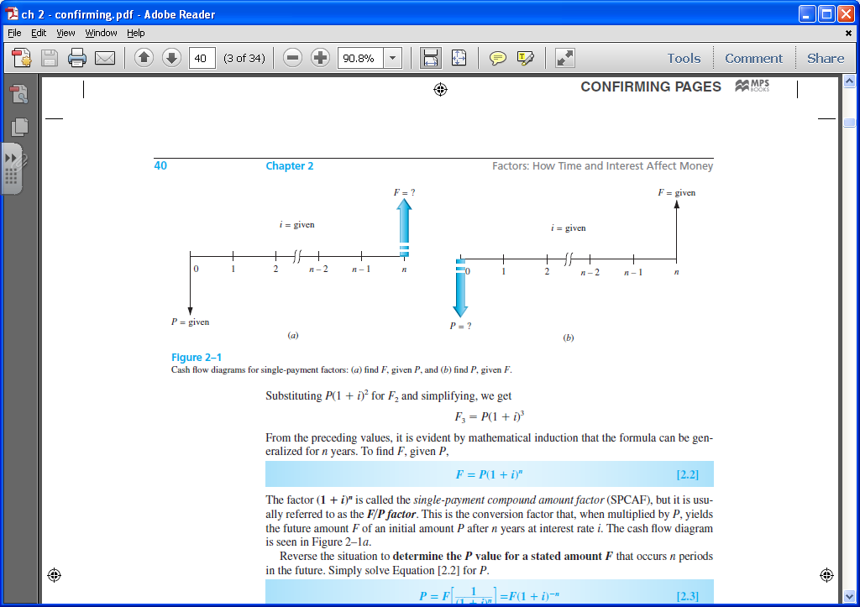
Single Payment Factors (F/P and P/F)
Single payment factors involve only P and F. Cash flow diagrams are as follows:
Formulas are as follows:
F = P(1 + i ) ^{n}
P = F[1 / (1 + i ) ^{n}]
Terms in parentheses or brackets are called factors. Values are in tables for i and n values
Factors are represented in standard factor notation such as (F/P,i,n),
where letter to left of slash is what is sought; letter to right represents what is given
© 2012 by McGraw-Hill, New York, N.Y All Rights Reserved
2-<number>

Slide 8
F/P and P/F for Spreadsheets
Future value F is calculated using FV function:
  = FV(i%,n,,P)
Present value P is calculated using PV function:
  = PV(i%,n,,F)
Note the use of double commas in each function
© 2012 by McGraw-Hill, New York, N.Y All Rights Reserved
2-<number>

Slide 9
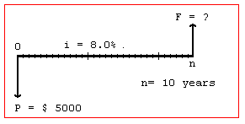
Example: Finding Future Value
A person deposits $5000 into an account which pays interest at a rate of 8% per year. The amount in the account after 10 years is closest to:
(A) $2,792 (B) $9,000 (C) $10,795 (D) $12,165
The cash flow diagram is:
Solution:
F = P(F/P,i,n )
= 5000(F/P,8%,10 )
= 5000(2.1589)
= $10,794.50
Answer is (C)
© 2012 by McGraw-Hill, New York, N.Y All Rights Reserved
2-<number>

Slide 10
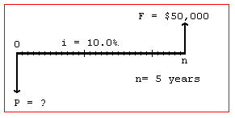
Example: Finding Present Value
A small company wants to make a single deposit now so it will have enough money to
purchase a backhoe costing $50,000 five years from now. If the account will earn
interest of 10% per year, the amount that must be deposited now is nearest to:
(A) $10,000 (B) $ 31,050 (C) $ 33,250 (D) $319,160
Solution:
The cash flow diagram is:
P = F(P/F,i,n )
= 50,000(P/F,10%,5 )
= 50,000(0.6209)
= $31,045
Answer is (B)
© 2012 by McGraw-Hill, New York, N.Y All Rights Reserved
2-<number>

Slide 11
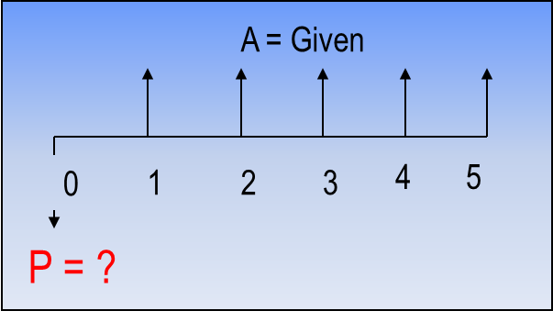
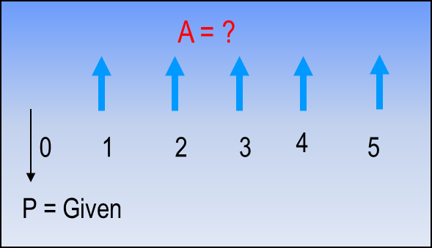
Uniform Series Involving P/A and A/P
The uniform series factors that involve P and A are derived as follows:
(1) Cash flow occurs in consecutive interest periods
(2) Cash flow amount is same in each interest period
The cash flow diagrams are:
P = A(P/A,i,n)
A = P(A/P,i,n)
Standard Factor Notation
Note: P is one period Ahead of first A value
© 2012 by McGraw-Hill, New York, N.Y All Rights Reserved
2-<number>

Slide 12
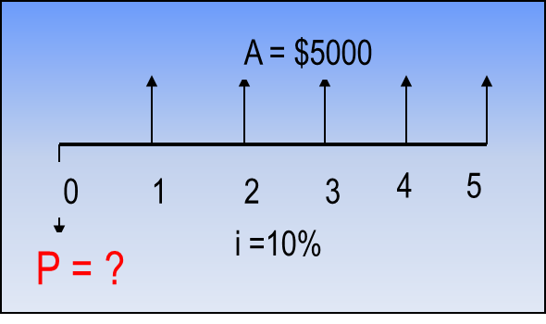
Example: Uniform Series Involving P/A
A chemical engineer believes that by modifying the structure of a certain water
treatment polymer, his company would earn an extra $5000 per year. At an interest
rate of 10% per year, how much could the company afford to spend now to just
break even over a 5 year project period?
(A) $11,170 (B) 13,640 (C) $15,300 (D) $18,950
Solution:
The cash flow diagram is as follows:
P = 5000(P/A,10%,5)
= 5000(3.7908)
= $18,954
Answer is (D)
© 2012 by McGraw-Hill, New York, N.Y All Rights Reserved
2-<number>

Slide 13
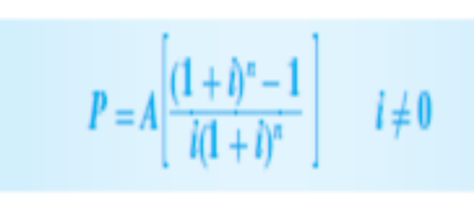
Example: Uniform Series Involving P/A
A chemical engineer believes that by modifying the structure of a certain water
treatment polymer, his company would earn an extra $5000 per year. At an interest
rate of 10% per year, how much could the company afford to spend now to just
break even over a 5 year project period?
(A) $11,170 (B) 13,640 (C) $15,300 (D) $18,950
The cash flow diagram is as follows:
© 2012 by McGraw-Hill, New York, N.Y All Rights Reserved
2-<number>

Slide 14
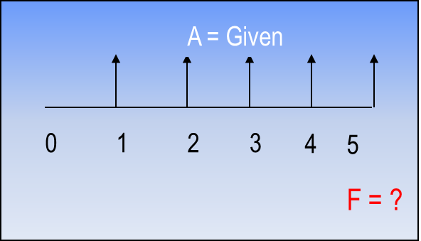
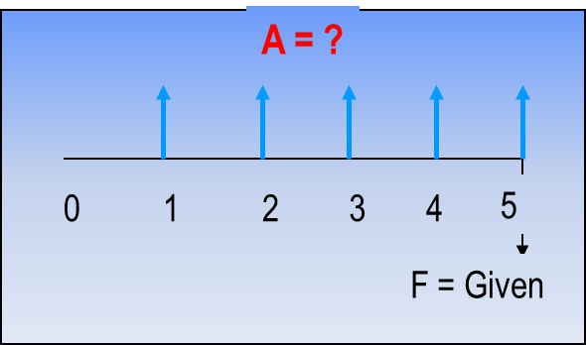
Uniform Series Involving F/A and A/F
The uniform series factors that involve F and A are derived as follows:
(1) Cash flow occurs in consecutive interest periods
(2) Last cash flow occurs in same period as F
Cash flow diagrams are:
F = A(F/A,i,n)
Standard Factor Notation
A = F(A/F,i,n)
Note: F takes place in the same period as last A
© 2012 by McGraw-Hill, New York, N.Y All Rights Reserved
2-<number>

Slide 15
Example: Uniform Series Involving F/A
An industrial engineer made a modification to a chip manufacturing process that will save her company $10,000 per year. At an interest rate of 8% per year, how much will the savings amount to in 7 years?
(A) $45,300 (B) $68,500 (C) $89,228 (D) $151,500
The cash flow diagram is:
F = ?
Solution:
F = 10,000(F/A,8%,7)
i = 8%
= 10,000(8.9228)
0 1 2 3 4 5 6 7
= $89,228
Answer is (C)
A = $10,000
© 2012 by McGraw-Hill, New York, N.Y All Rights Reserved
2-<number>

Slide 16
Factor Values for Untabulated i or n
3 ways to find factor values for untabulated i or n values
Use formula
Use spreadsheet function with corresponding P, F, or A value set to 1
Linearly interpolate in interest tables
Formula or spreadsheet function is fast and accurate
Interpolation is only approximate
© 2012 by McGraw-Hill, New York, N.Y All Rights Reserved
2-<number>

Slide 17
Example: Untabulated i
Determine the value for (F/P, 8.3%,10)
Formula: F = (1 + 0.083)¹⁰ = 2.2197
OK
Spreadsheet: = FV(8.3%,10,,1) = 2.2197
OK
Interpolation: 8% ------ 2.1589
8.3% ------ x
9% ------ 2.3674
x = 2.1589 + [(8.3 - 8.0)/(9.0 - 8.0)][2.3674 – 2.1589]
= 2.2215
(Too high)
Absolute Error = 2.2215 – 2.2197 = 0.0018
© 2012 by McGraw-Hill, New York, N.Y All Rights Reserved
2-<number>

Slide 18
Arithmetic Gradients
Assume a manufacturing engineer predicts that the cost of maintaining a robot will increase by $5000 per year until the machine is retired. The cash flow series of maintenance costs involves a constant gradient, which is $5000 per year.
An arithmetic gradient series is a cash flow series that either increases or decreases by a constant amount each period.
The amount of change is called the gradient.
Gradients may be positive or negative amounts, but they increase or decrease in absolute value
over time
2-<number>

Slide 19
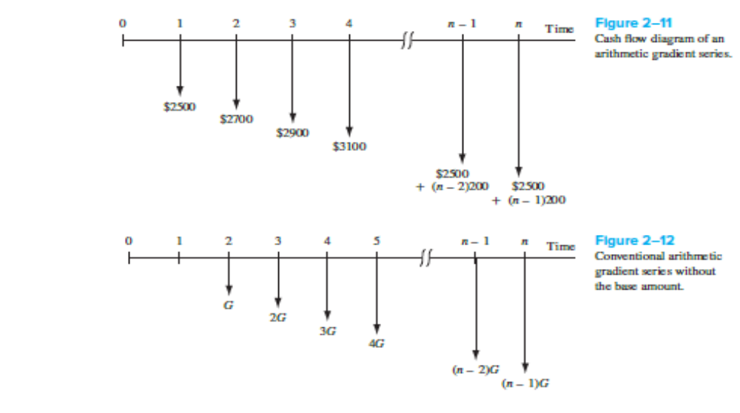
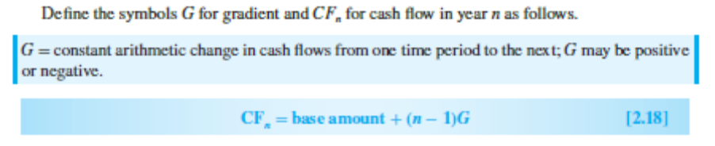
Arithmetic Gradients
2-<number>

Slide 20
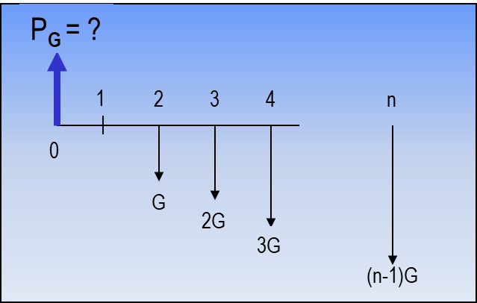
Arithmetic Gradients
Arithmetic gradients change by the same amount each period
The cash flow diagram for the P_{G}
of an arithmetic gradient is:
G starts between periods 1 and 2
(not between 0 and 1)
This is because cash flow in year 1 is usually not equal to G and is handled separately as a base amount
(shown on next slide)
Note that P_{G} is located Two Periods Ahead of the first change that is equal to G
Standard factor notation is
P_{G} = G(P/G,i,n)
© 2012 by McGraw-Hill, New York, N.Y All Rights Reserved
2-<number>

Slide 21
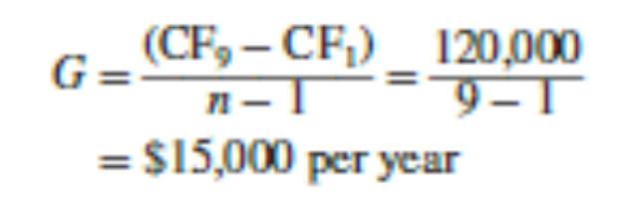
Example 2.8
A local university has initiated a logo-licensing program with the clothier Holister, Inc. Estimated fees (revenues) are $80,000 for the first year with uniform increases to a total of $200,000 by the end of year 9. Determine the gradient and construct a cash flow diagram that identifies the base amount and the gradient series.
The year 1 base amount is CF1 = $80,000, and the total increase over 9 years is
CF9 − CF1 = 200,000 – 80,000 = $120,000
© 2012 by McGraw-Hill, New York, N.Y All Rights Reserved
1-<number>

Slide 22
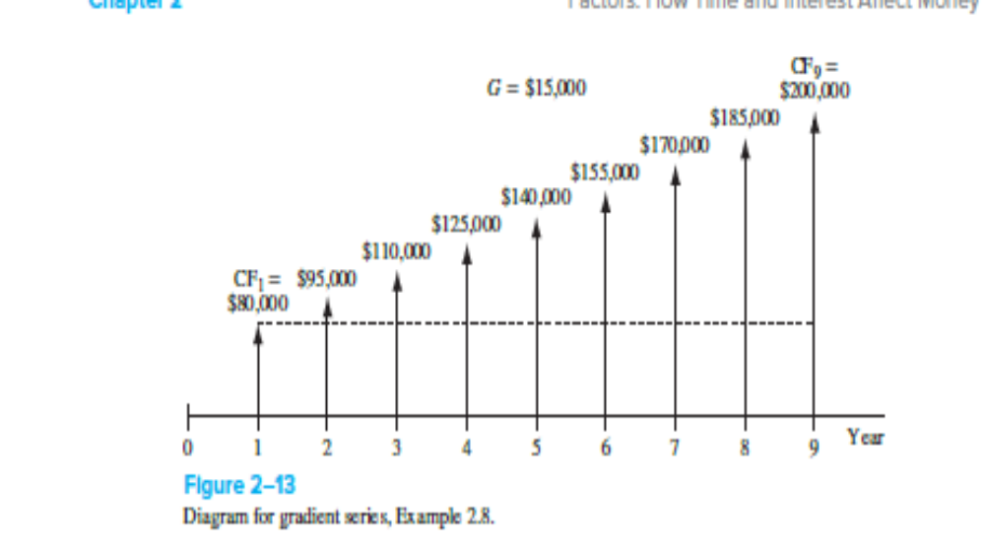
Example
© 2012 by McGraw-Hill, New York, N.Y All Rights Reserved
1-<number>

Slide 23
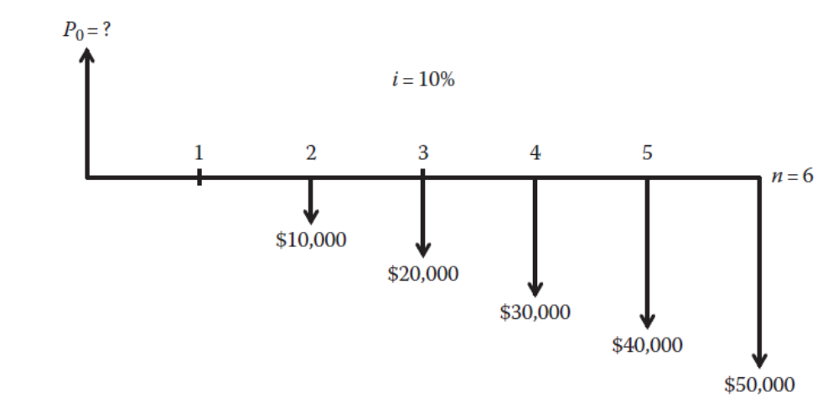
A nuclear engineer has to determine the amount of money her firm may borrow to purchase a new machine if the firm is able to start repaying the loan by paying $10,000.00 in year two increasing by $10,000.00 a year until year six with an interest rate of 10%.
1-<number>

Slide 24
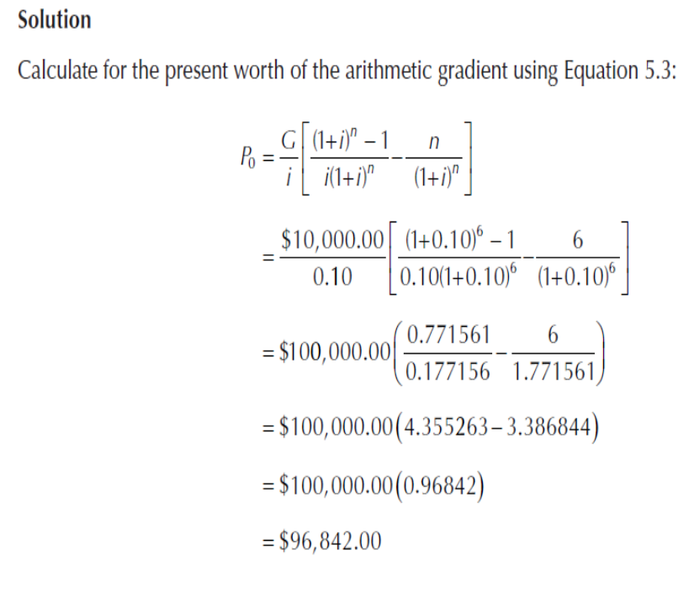
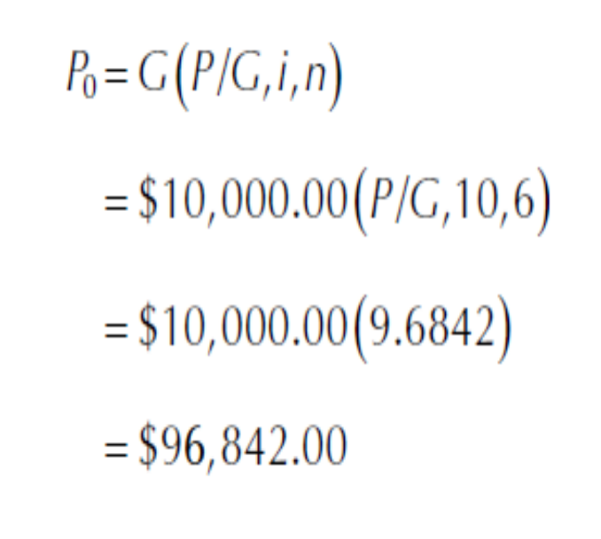
A nuclear engineer has to determine the amount of money her firm may borrow to purchase a new machine if the firm is able to start repaying the loan by paying $10,000.00 in year two increasing by $10,000.00 a year until year six with an interest rate of 10%.
1-<number>

Slide 25
Typical Arithmetic Gradient Cash Flow
P_{T} = ?
i = 10%
0 1 2 3 4 5
400
Amount in year 1
is base amount
450
500
550
600
This diagram = this base amount plus this gradient
P_{A} = ?
P_{G} = ?
i = 10%
i = 10%
0 1 2 3 4 5
+
0 1 2 3 4 5
Amount in year 1
is base amount
400
400
400
400
400
50
P_{G} = 50(P/G,10%,5)
100
P_{A} = 400(P/A,10%,5)
150
200
P_{T} = P_{A} + P_{G} = 400(P/A,10%,5) + 50(P/G,10%,5)
© 2012 by McGraw-Hill, New York, N.Y All Rights Reserved
2-<number>

Slide 26
Converting Arithmetic Gradient to A
Arithmetic gradient can be converted into equivalent A value using G(A/G,i,n)
i = 10%
i = 10%
0 1 2 3 4 5
0 1 2 3 4 5
G
A = ?
2G
3G
4G
General equation when base amount is involved is
A = base amount + G(A/G,i,n)
For decreasing gradients,
change plus sign to minus
0 1 2 3 4 5
4G
3G
A = base amount - G(A/G,i,n)
2G
G
© 2012 by McGraw-Hill, New York, N.Y All Rights Reserved
2-<number>

Slide 27
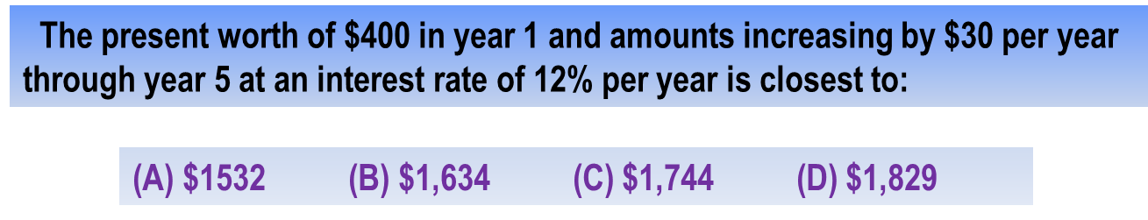
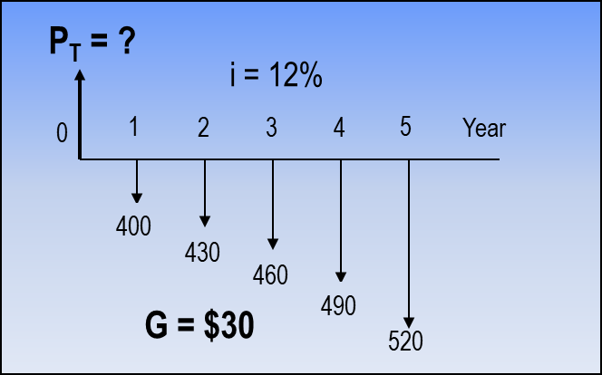
Example: Arithmetic Gradient
Solution:
P_{T} = 400(P/A,12%,5) + 30(P/G,12%,5)
= 400(3.6048) + 30(6.3970)
= $1,633.83
Answer is (B)
The cash flow could also be converted
into an A value as follows:
A = 400 + 30(A/G,12%,5)
= 400 + 30(1.7746)
= $453.24
© 2012 by McGraw-Hill, New York, N.Y All Rights Reserved
2-<number>

Slide 28
Present worth of an arithmetic gradient and a uniform annual series
A construction firm pays $5,000.00 for the first year of a maintenance service contract that increases by $1,000.00 in each subsequent year until year six. If the interest rate is 10%, what would be the present worth of the uniform annual series and the gradient? Figure 5.9 is the cash flow diagram for the maintenance service contract.
© 2012 by McGraw-Hill, New York, N.Y All Rights Reserved
1-<number>

Slide 29
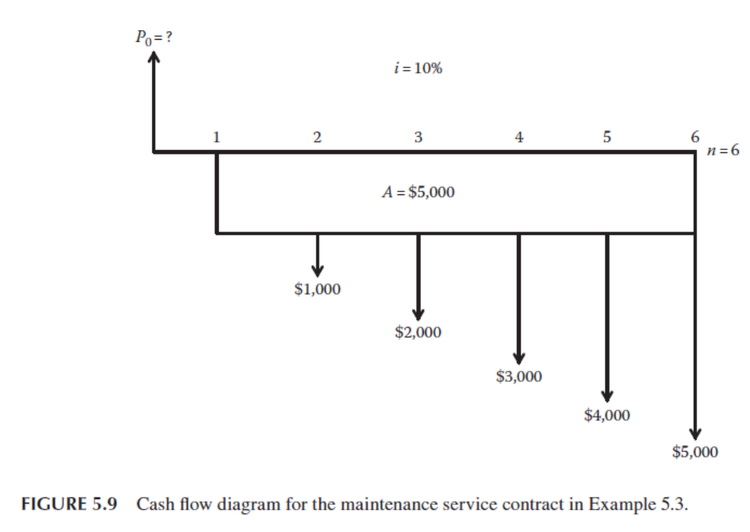
1-<number>

Slide 30
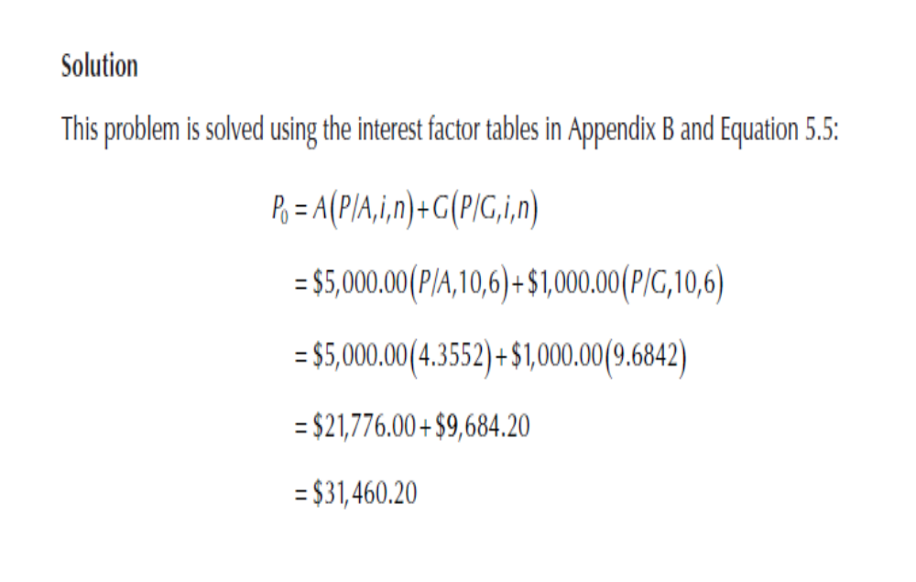
© 2012 by McGraw-Hill, New York, N.Y All Rights Reserved
1-<number>

Slide 31
Geometric Gradients
Geometric gradients change by the same percentage each period
Cash flow diagram for present worth
of geometric gradient
There are no tables for geometric factors
Use following equation for g ≠ i:
P_{g} = ?
1
2
3
4
n
P_{g} = A₁{1- [(1+g)/(1+i)]^{n}}/(i-g)
0
where: A₁ = cash flow in period 1
g = rate of increase
If g = i, P_{g} = A₁n/(1+i)
A₁
A ₁(1+g)¹
A ₁(1+g)²
Note: g starts between
periods 1 and 2
A ₁(1+g)^{n-1}
Note: If g is negative, change signs in front of both g values
© 2012 by McGraw-Hill, New York, N.Y All Rights Reserved
2-<number>

Slide 32
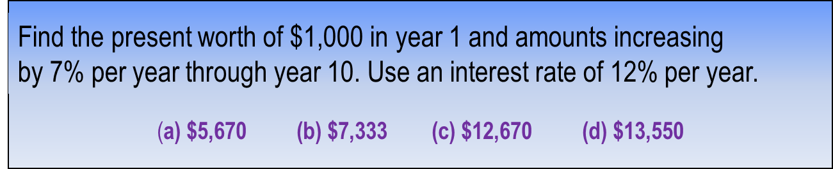
Example: Geometric Gradient
P_{g} = ?
Solution:
i = 12%
1
2
3
4
10
P_{g} = 1000[1-(1+0.07/1+0.12)¹⁰]/(0.12-0.07)
= $7,333
0
1000
1070
Answer is (b)
1145
g = 7%
1838
To find A, multiply P_{g} by (A/P,12%,10)
© 2012 by McGraw-Hill, New York, N.Y All Rights Reserved
2-<number>

Slide 33

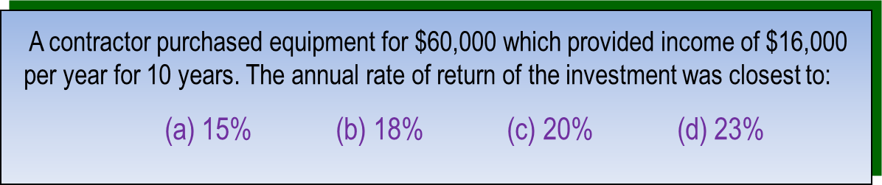
Unknown Interest Rate i
(Usually requires a trial and error solution or interpolation in interest tables)
Procedure: Set up equation with all symbols involved and solve for i
Solution:
Can use either the P/A or A/P factor. Using A/P:
60,000(A/P,i%,10) = 16,000
(A/P,i%,10) = 0.26667
From A/P column at n = 10 in the interest tables, i is between 22% and 24%
Answer is (d)
2-<number>
© 2012 by McGraw-Hill, New York, N.Y All Rights Reserved

Slide 34
Unknown Recovery Period n
Unknown recovery period problems involve solving for n,
given i and 2 other values (P, F, or A)
(Like interest rate problems, they usually require a trial & error solution or interpolation in interest tables)
Procedure: Set up equation with all symbols involved and solve for n
A contractor purchased equipment for $60,000 that provided income of $8,000
per year. At an interest rate of 10% per year, the length of time required to recover
the investment was closest to:
(a) 10 years (b) 12 years (c) 15 years (d) 18 years
Solution:
Can use either the P/A or A/P factor. Using A/P:
60,000(A/P,10%,n) = 8,000
(A/P,10%,n) = 0.13333
From A/P column in i = 10% interest tables, n is between 14 and 15 years
Answer is (c)
© 2012 by McGraw-Hill, New York, N.Y All Rights Reserved
2-<number>

Slide 35
Summary of Important Points
In P/A and A/P factors, P is one period ahead of first A
In F/A and A/F factors, F is in same period as last A
To find untabulated factor values, best way is to use formula or spreadsheet
For arithmetic gradients, gradient G starts between periods 1 and 2
Arithmetic gradients have 2 parts, base amount (year 1) and gradient amount
For geometric gradients, gradient g starts been periods 1 and 2
In geometric gradient formula, A₁ is amount in period 1
To find unknown i or n, set up equation involving all terms and solve for i or n
© 2012 by McGraw-Hill, New York, N.Y All Rights Reserved
2-<number>

